Slide 1
Jumping for JavaScript
Lesson 2.2

Slide 2
Today’s Class

Slide 3
Objectives
In today’s class, we’ll cover:
Array Assignments
The Concept of for Loops
The Art of Pseudocoding
Building Rock-Paper-Scissors

Slide 4
Basics Recap

Slide 5

What is JavaScript?
(And what is it used for?)

Slide 6


JavaScript Definitions
JavaScript is the third of the three fundamental programming languages of the modern web (along with HTML and CSS).
JavaScript allows developers to create dynamic web applications capable of taking in user inputs, changing what’s displayed to users, animating elements, and much more.

Slide 7
What is a Variable?
(And how do we declare one?)

Slide 8
Variable Basics
Variables are the nouns of programming.
They are “things” (numbers, strings, Booleans, etc.).
A variable is composed of a variable name and a value.
var name = "Snow White"; var dwarfCount = 7; var isSleeping = true;

Slide 9
What is meant by console.log?
(And how does it differ from an alert, prompt, or confirm?)

Slide 10
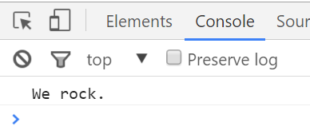
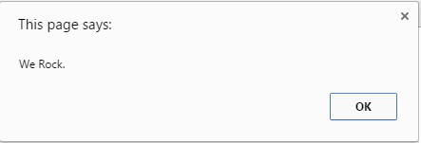
Basic Variables
console.log displays discreetly to the debugger.
alert displays a pop-up message to the user.
console.log("We rock.");
alert("We Rock.");

Slide 11
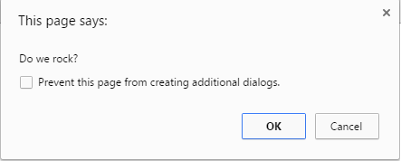
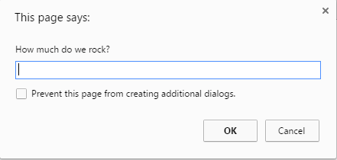
Basic Variables
confirm displays a true/false popup.
alert displays a prompt with a text-box input.
confirm("Do we rock?");
prompt("How much do we rock?");

Slide 12
How do we check conditions?

Slide 13
If/Else statements are critical
Each statement is composed of an if, else-if, or else (keyword), a condition, and the resulting code in { } curly brackets.
// If the user likes sushi (confirmSushi === true), we run the following block of code. if (confirmSushi) { alert("You like " + sushiType + "!"); } // If the user likes ginger tea (confirmGingerTea === true), we run the following block of code. else if (confirmGingerTea) { alert("You like ginger tea!!"); } // If neither of the previous condition were true, we run the following block of code. else { alert("You don’t like sushi or ginger tea.");

Slide 14
What is an array?

Slide 15
Basic Arrays
Arrays a type of variable that are collections.
These collections can be made up of strings, numbers, Booleans, other arrays, objects, anything.
Each element of the array is marked by an index. Indexes always start with 0.
var nickCharacters = ["Tommy", "Doug", "Oblina"]; var diceNumbers = [1, 2, 3, 4, 5, 6,]; var mixedArray = ["Zoo", 12, "Carrot", 3];

Slide 16
Notes:
PAUSE

Slide 17
10 minutes
Partner Activity: Array Building

Slide 18
Partner Activity: Array Building
Suggested Time: 10 minutes
01
Run the program sent to you via Slack.
02
Then, with a partner, fill in the missing comments for each line of code.
03
Make sure both of you can fully explain what each line means.
Be prepared to share with the class.
04

Slide 19
Logging: No Functions

Slide 20
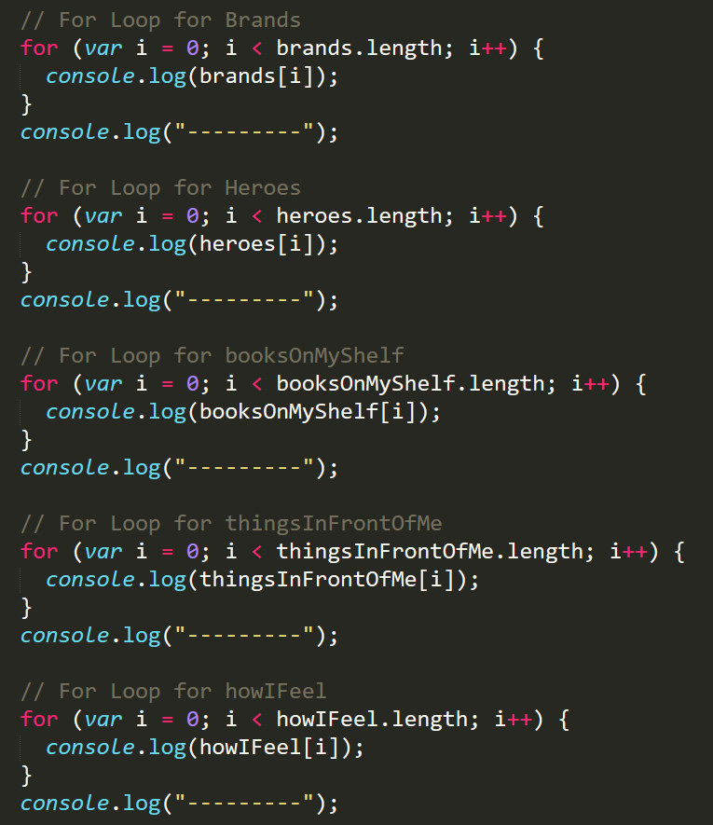


Mondo Repetitive
Who wants to maintain this?
Hint: No one.

Slide 21
Logging: With Functions

Slide 22
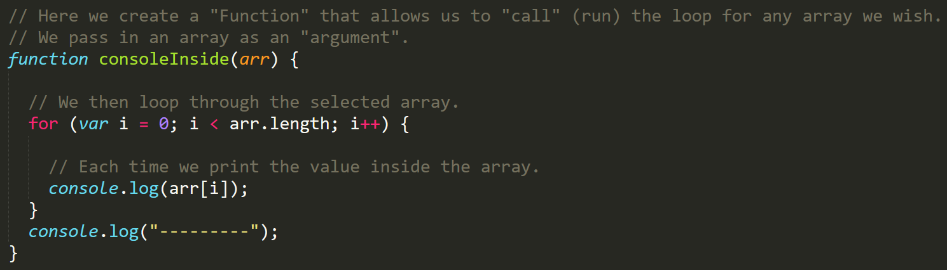
Much Better with Functions!
Squeaky clean code. Minimal repetition.

Slide 23
20 minutes
Partner Activity: My First Functions
JavaScript Juggernauts

Slide 24


Partner Activity: My First Functions
Suggested Time: 20 minutes
Working in pairs and using the starter file sent to you via Slack, fill in the missing functions and function calls.
Note: Try to finish all four functions if you can, but don’t be distressed if you only get 1 or 2. The important thing is that you get at least one function fully done.
HINT: Look back to the previous example if you need help.
JavaScript Juggernauts

Slide 25
Questions?
Jumping for JavaScript

